Slide 1
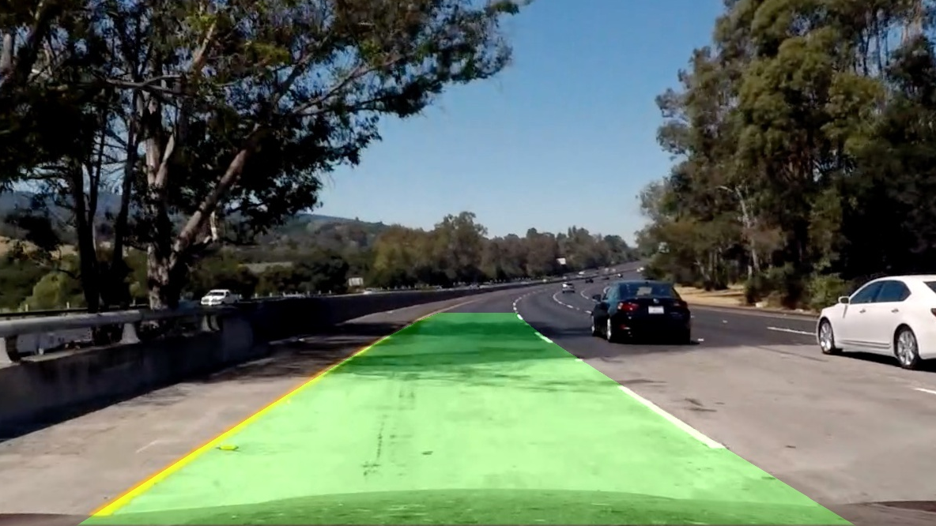
ADVANCED LANE FINDING

Slide 2
The Project
The goals / steps of this project are the following:
* Compute the camera calibration matrix and distortion coefficients given a set of chessboard images.
* Apply a distortion correction to raw images.
* Use color transforms, gradients, etc., to create a thresholded binary image.
* Apply a perspective transform to rectify binary image ("birds-eye view").
* Detect lane pixels and fit to find the lane boundary.
* Determine the curvature of the lane and vehicle position with respect to center.
* Warp the detected lane boundaries back onto the original image.
* Output visual display of the lane boundaries and numerical estimation of lane curvature and vehicle position.

Slide 3
Camera Calibration
The code for this step is contained in lines #10 through #32 of the file called pipeline.py
I start by preparing "object points", which will be the (x, y, z) coordinates of the chessboard corners in the world. Here I am assuming the chessboard is fixed on the (x, y) plane at z=0, such that the object points are the same for each calibration image. Here the printed chessboard is set to 6*9 corners for objp as mentioned in the guidelines.
objp is just a replicated array of coordinates, and objpoints will be appended with a copy of it every time I successfully detect all chessboard corners in a test image using the function cv2.findChessboardCorners() on all the images also specifying the number of corners.imgpoints will be appended with the (x, y) pixel position of each of the corners in the image plane with each successful chessboard detection.

Slide 4
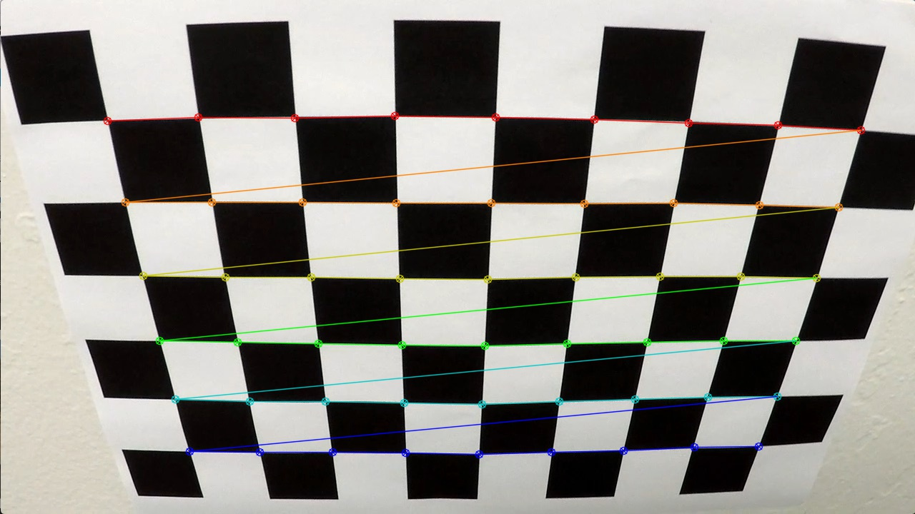
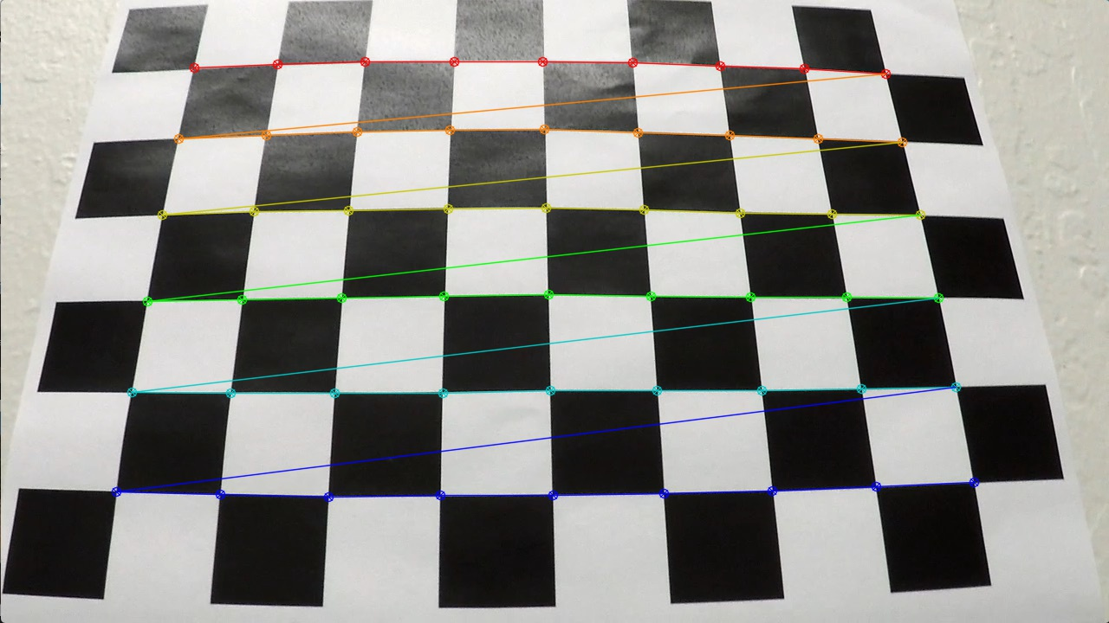
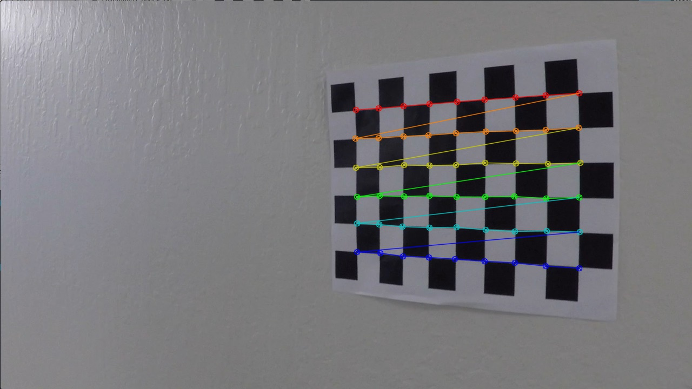
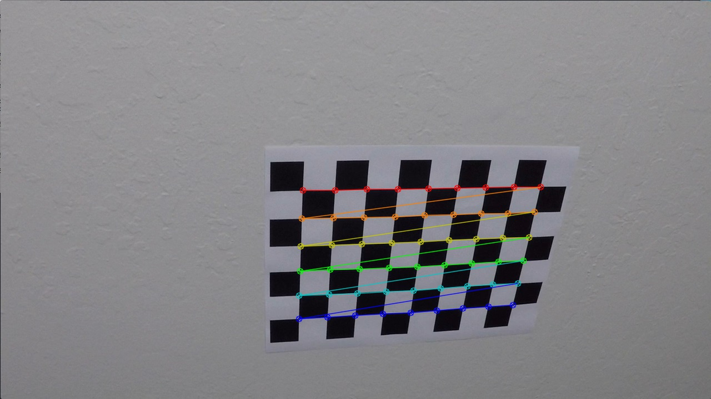
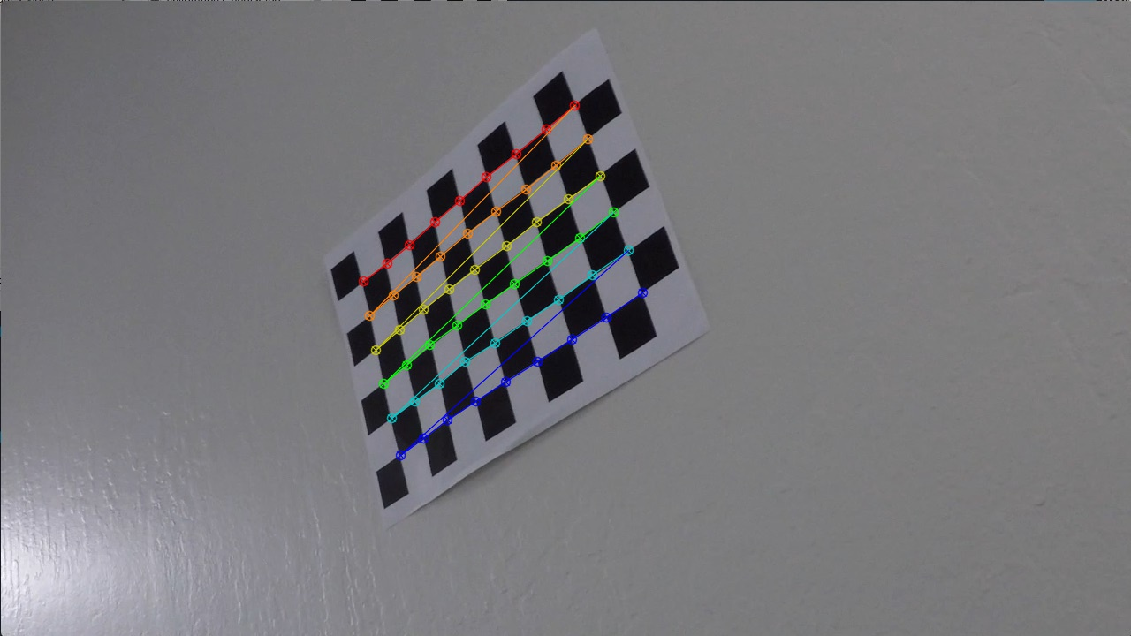
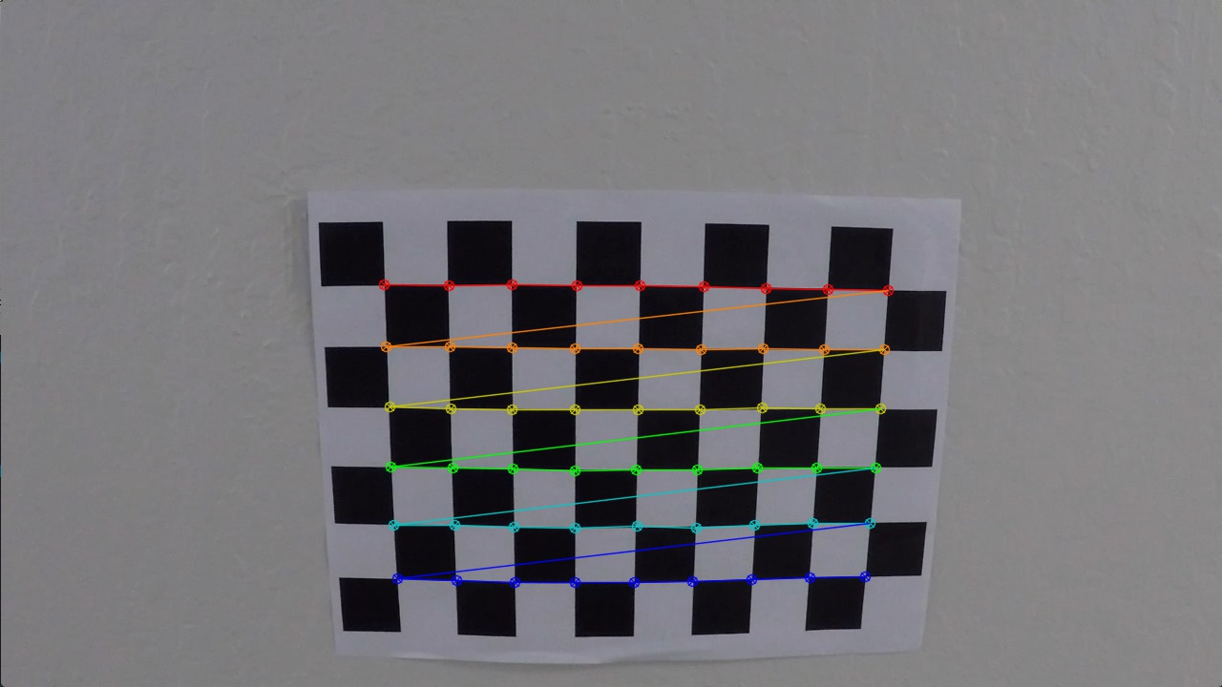
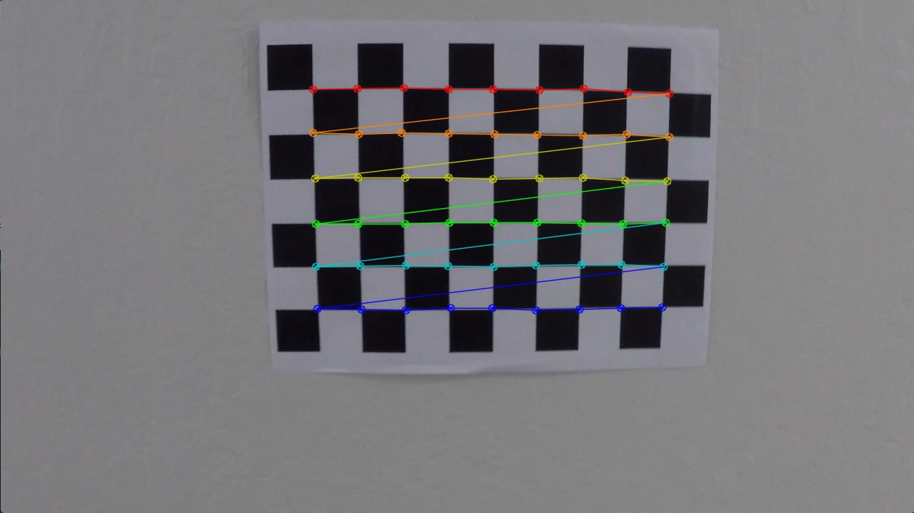
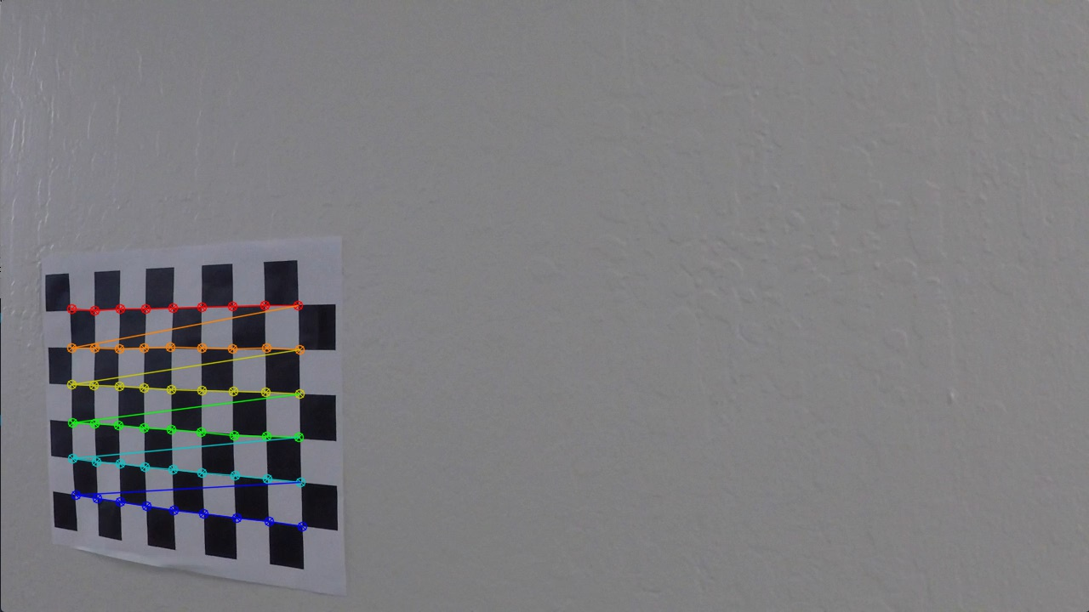
Camera Calibration
Following are some of the chessboard corner images:

Slide 5
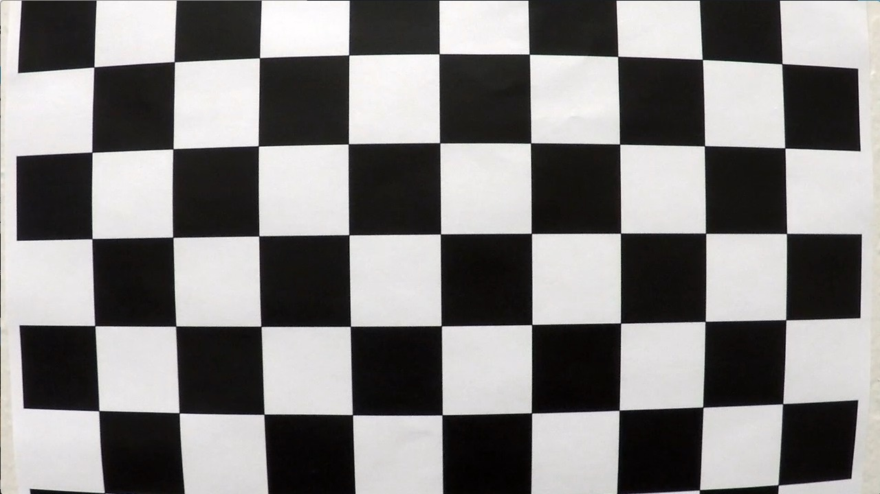
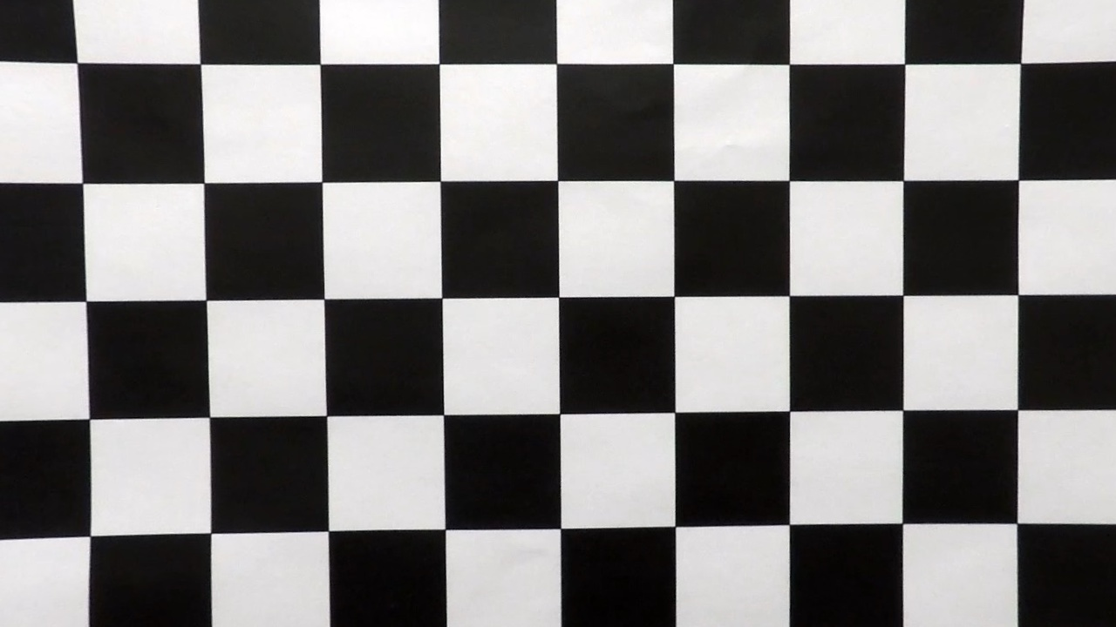
Camera Calibration
I then used the output objpoints and imgpoints to compute the camera calibration and distortion coefficients using the cv2.calibrateCamera() function.
Finally, I applied this distortion correction to one of the chessboard images under camera_cal folder using the cv2.undistort() function and obtained this result:
ORIGINAL IMAGE
UNDISTORTED IMAGE

Slide 6
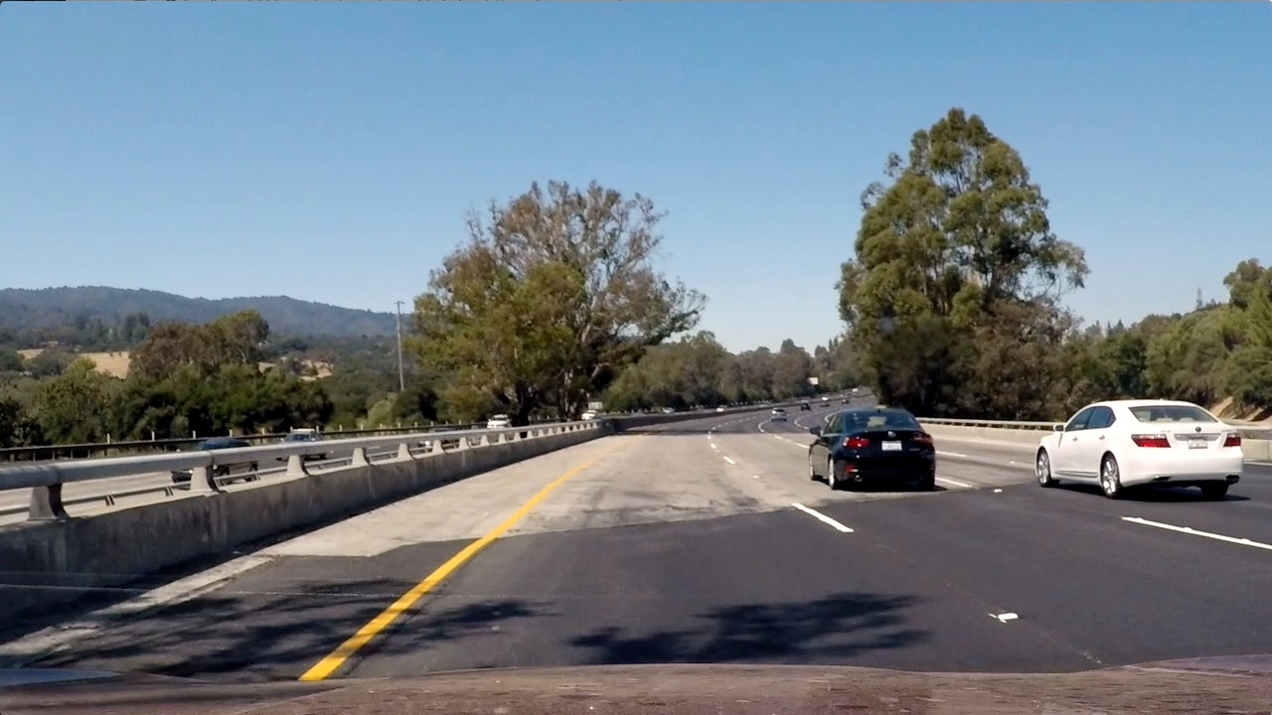
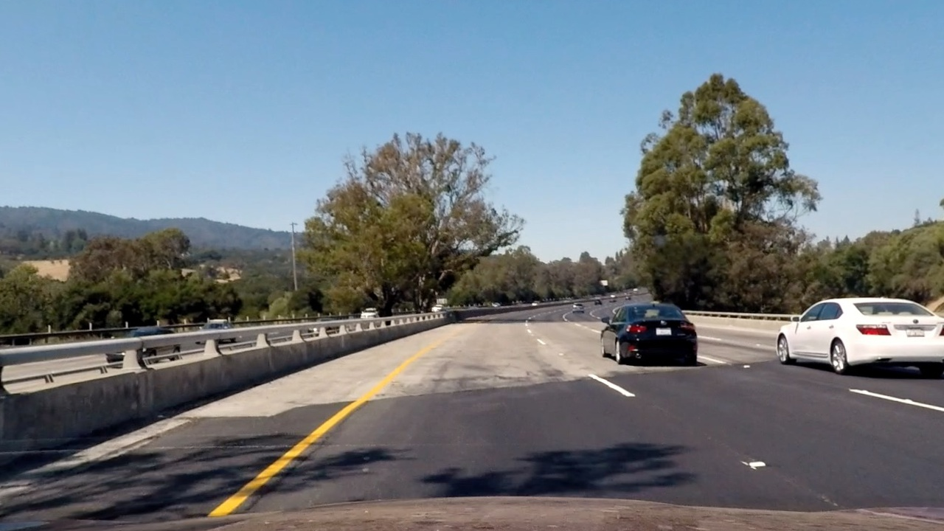
PIPELINE – DISTORTION CORRECTION
Using the values obtained by camera calibration function defined in the previous step I applied cv2.undistort() to one of the test example image and this is the result:
ORIGINAL IMAGE
UNDISTORTED IMAGE

Slide 7
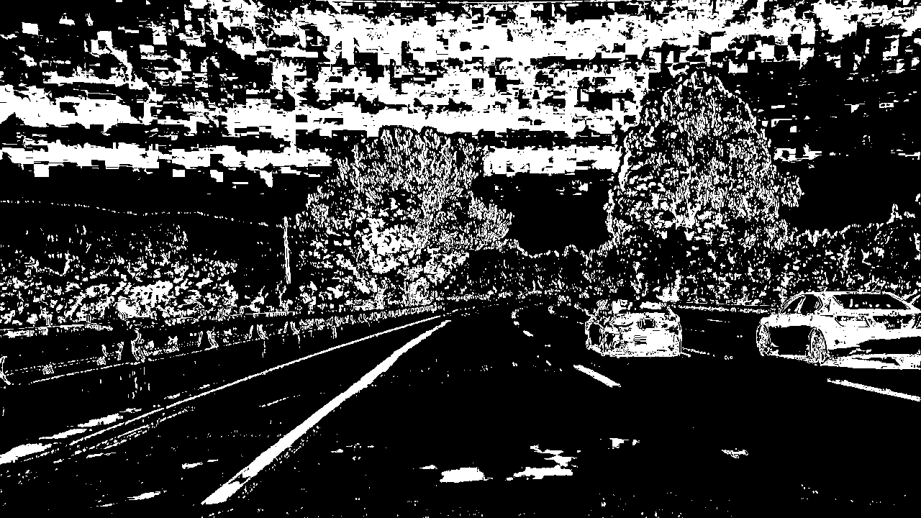
PIPELINE – BINARY IMAGE
I used a combination of color and gradient thresholds to generate a binary image (thresholding steps at lines #48 through #68 in `pipeline.py`). The final image is a combination of color thresholding the R & S channel and result of gradient thresholding the L channel by applying the Sobel operator in the x direction on the undistorted image. The shadows are removed from R channel using createBackgroundSubtractorMOG2.
UNDISTORTED IMAGE
BINARY IMAGE

Slide 8
PIPELINE – PERSPECTIVE TRANSFORM
The code for my perspective transform is defined in the function called warper() , which appears in lines #70 through #88 in the file pipeline.py. The warper() function takes as inputs an image. I chose the hardcoded source and destination points in the following manner:
offset = 350 # offset for dst points
# Source points
src = np.float32([[600, 450],
[680, 450],
[img_size[0]-300, 680],
[380, 680]])
# destination points
dst = np.float32([[offset, 0],
[img_size[0]-offset, 0],
[img_size[0]-offset, img_size[1]],
[offset, img_size[1]]])
This resulted in the following source and destination points:
Source | Destination
610, 450 | 350, 0
680, 450 | 930, 0
980, 680 | 930, 720
380, 680 | 350, 720

Slide 9
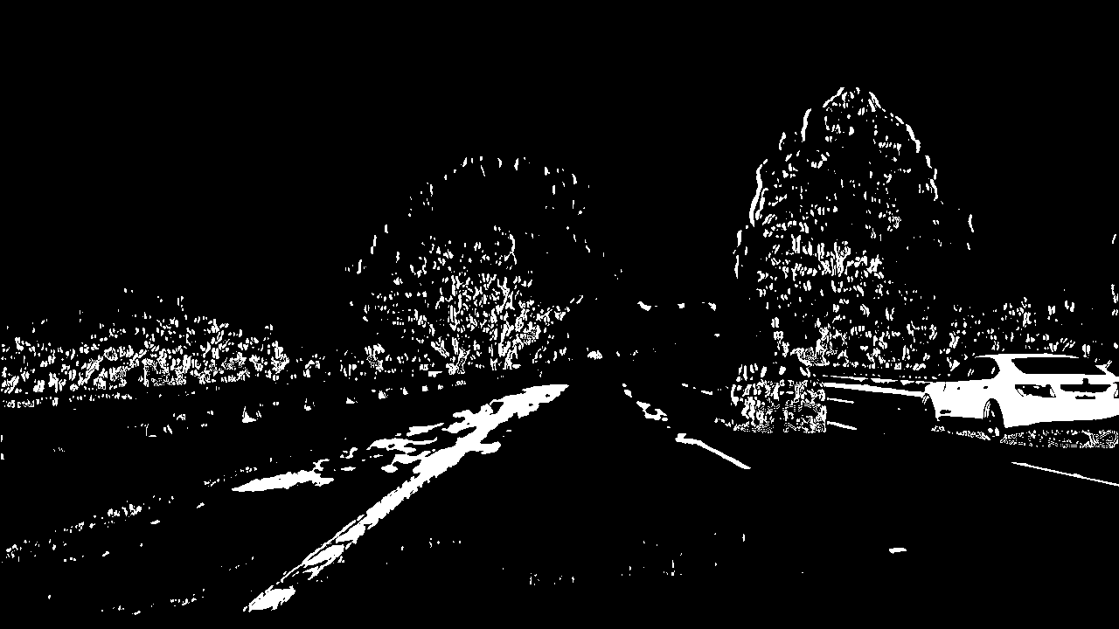
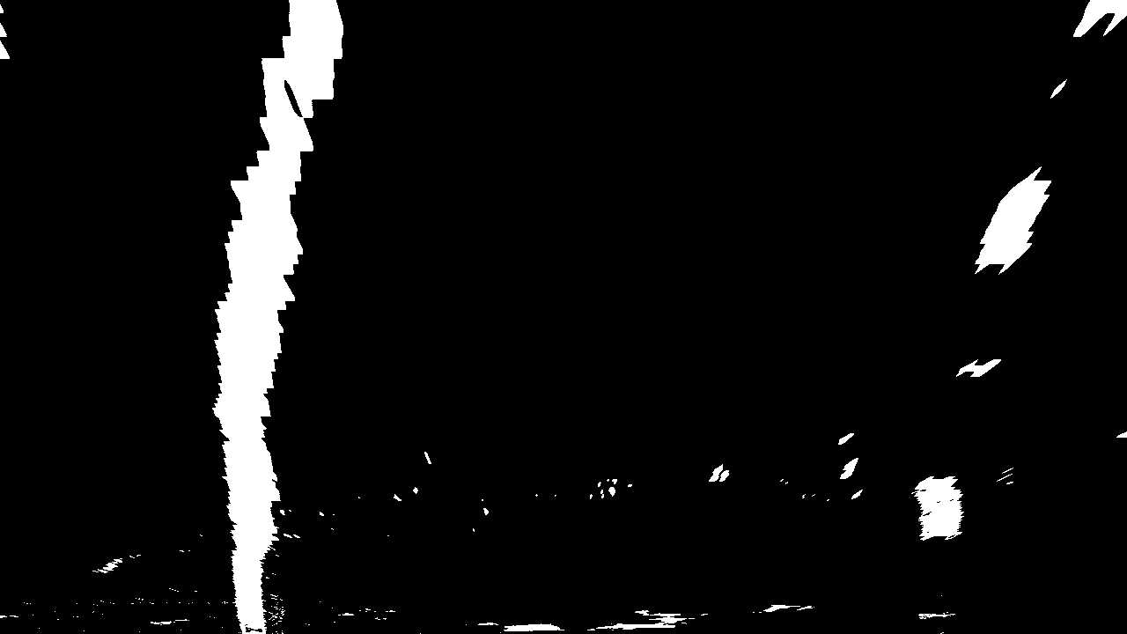
PIPELINE – PERSPECTIVE TRANSFORM
I verified that my perspective transform was working as expected by drawing the source and destination points onto a test image and its warped counterpart to verify that the lines appear parallel in the warped bird-view image.
In the example below I applied perspective transform to the binary image from previous step.
BINARY IMAGE
BIRD’S EYE VIEW IMAGE

Slide 10
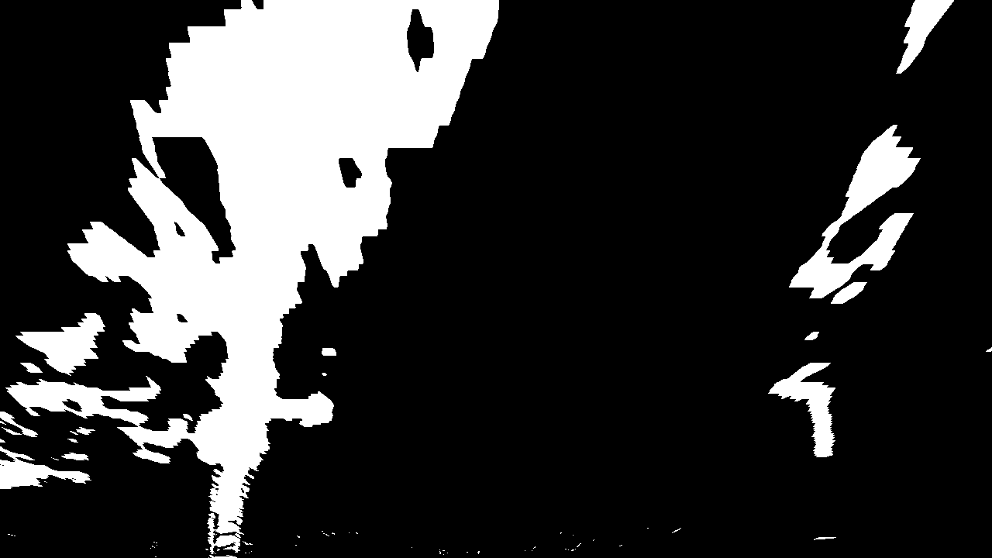
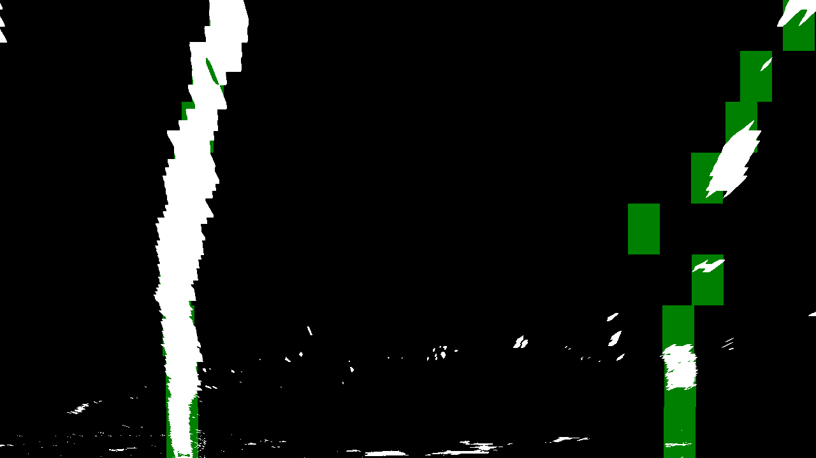
PIPELINE – LANE FITTING
Here I applied a convolution find_window_centroids(), which maximized the number of "hot" pixels in each window. A convolution is the summation of the product of two separate signals, in our case the window template and the vertical slice of the pixel image. You slide your window template across the image from left to right and any overlapping values are summed together, creating the convolved signal. The peak of the convolved signal is where there was the highest overlap of pixels and the most likely position for the lane marker. Also the image is divided into 9 equal height horizontal slips and each applied sliding window. The below result is applying the convolution on the previous wrapped top view image.
WRAPPED TOP VIEW IMAGE
FITTED IMAGE

Slide 11
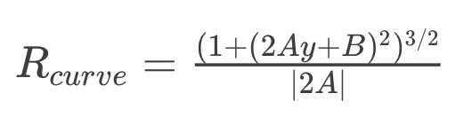
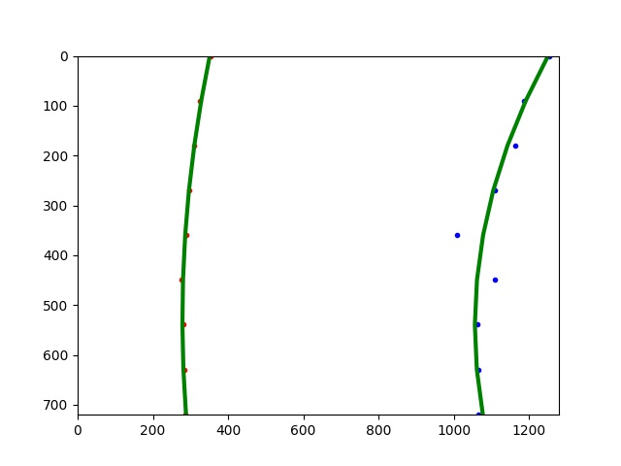
PIPELINE – LANE CURVATURE
I implemented this step in lines #155 through #174 in my code in pipeline.py in the function curvature () which uses the left and right points found by find_window_centroids() to calculate the center of the image as well as the left and right Radius of curvature using the following equation.
Here is an example of my result on previous image.

Slide 12
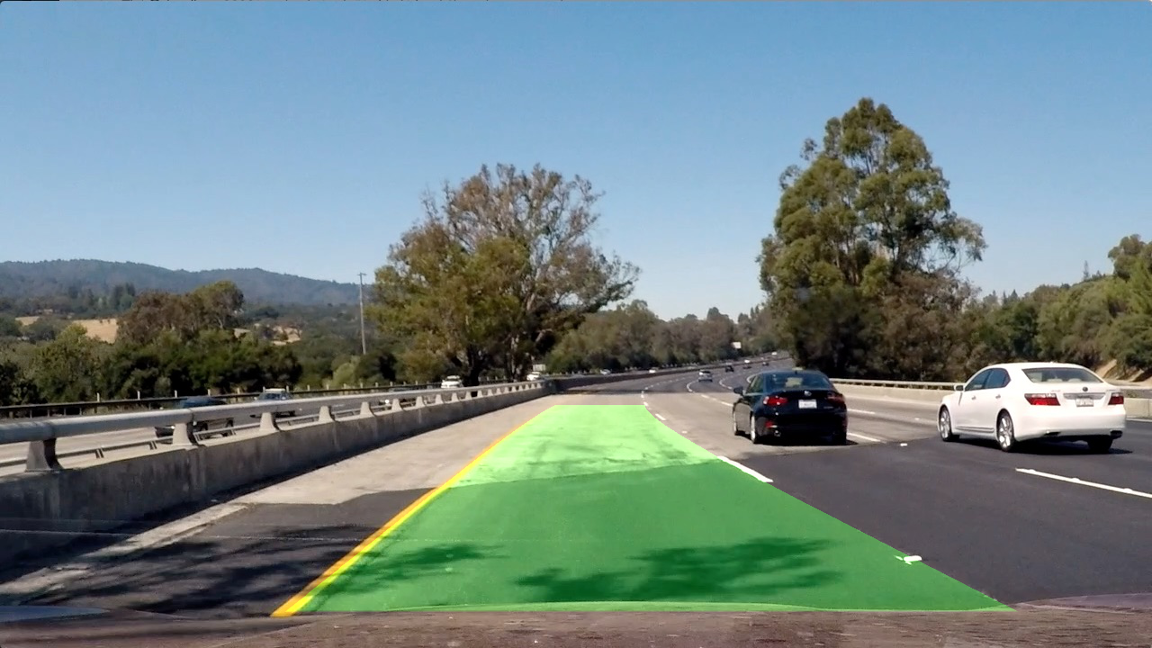
PIPELINE – WARP BACK ONTO ORIGINAL IMAGE
I implemented this step in lines #176 through #187 in my code in `pipeline.py` in the function `warpBack()`. Here is an example of my result on a test image:

Slide 13
PIPELINE – VIDEO
For the video, pipeline takes video clip image as an input and invokes all the previously defined functions, further doing a quick sanity check. In addition I make sure that the lanes have a valid separation and if it fails then I draw lane lines based on the previous estimation. For the annotation, I have used cv2.putText() to write on top of the image. Final video output is provided in the zip – file name ‘project_video_final.mp4’.

Slide 14
DISCUSSION
For the most parts, the guidelines provided in the classroom worked well on the project without having to alter the code. The most challenging part of this project is coming up with a lane line detection and thresholding algorithm that is robust for the project. In the end I settled with using color thresholding and directional gradient in x direction, initially having experimented with directional and magnitude threshold which didn’t seem to work well for the project. Tuning different thresholds and combining them is a very time-consuming, with little guarantee that the parameters that work well on samples would also work well on video. The source and the destination points for the warping were hardcoded this could be improved by implementing a learning based system would be more flexible and robust.
Possible improvements would be to improve the color thresholding to only detect white and yellow lane lines and mask the rest from the input. Other areas to explore for improvements is to look at bettering the look-ahead filter and the smoothing algorithm to obtain a cleaner result.

